Slide 1
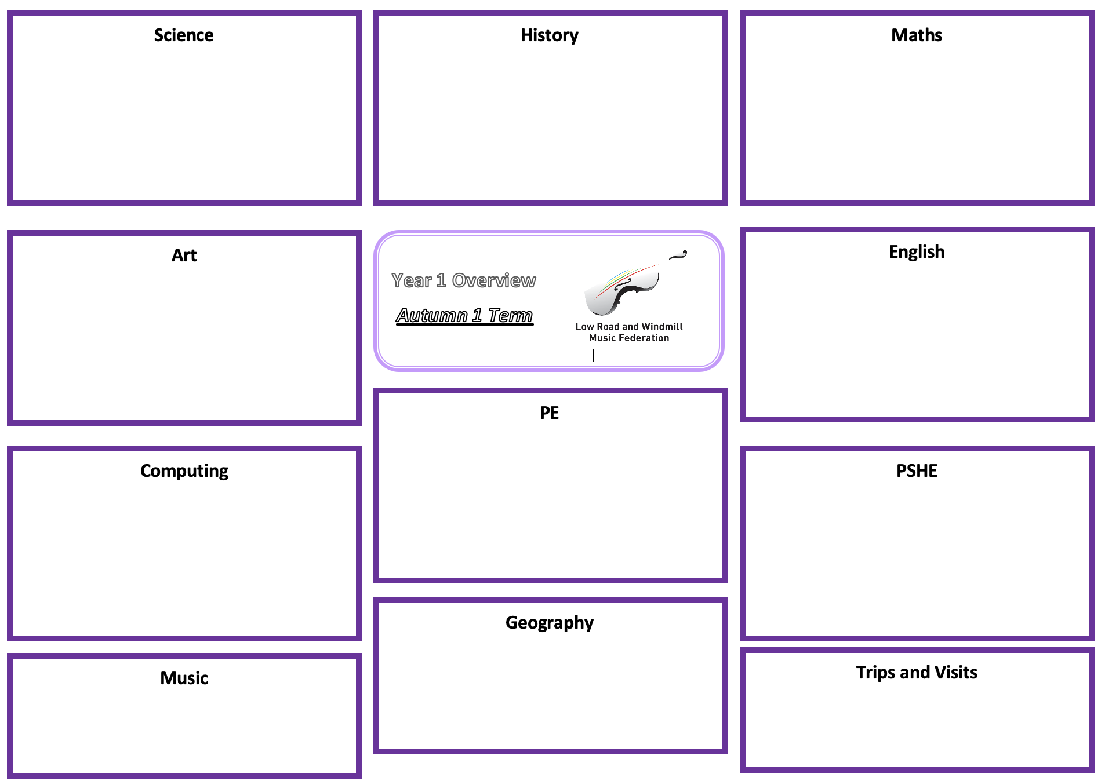
Science: Rocks – Rocks and Fossils
History: The Bronze Age and The Iron Age
Maths
Compare and group together different kinds of rocks
Describe in simple terms how fossils are formed
Recognise that soils are made from rocks and organic matter
Asking relevant questions and using different types of scientific enquiries to answer them
Setting up simple practical enquiries, comparative and fair tests
Making systematic and careful observations
Gathering, recording, classifying and presenting data in a variety of ways to help in answering questions
Recording findings
Reporting on findings from enquiries, including oral and written explanations.
Using results to draw simple conclusions, make predictions for new values, suggest improvements and raise further questions
Identifying differences, similarities or changes related to simple scientific ideas and processes
Using straightforward scientific evidence to answer questions or to support their findings
Use common words and phrases relating to the passing of time
Develop a chronologically secure knowledge and understanding of British history
Address historically valid questions about change, similarity and difference
Develop the use of historical terms
Understand how our knowledge of the past is constructed from a range of sources
Construct informed responses that involve thoughtful selection and organisation of relevant historical information
Address historically valid questions about trends and significance.
See individual teachers MTP for specific outcomes
Number: Multiplication, division and fractions
Measurement: Length and perimeter
Art: Painting
Year 3 Overview
Spring 1
English:
Explore using a range of brushes and techniques (larger strokes for colour washes, shorter strokes/dabbing for detail, swirls to show movement)
Mix colours effectively, mix and match colours to colour palette
Lighten and darken tones using black and white
Use watercolour paints to create washes and to add detail
Create paintings from direct observation and experimenting with abstract elements such as scale and unexpected colour palettes
Collect and annotate images in sketchbook of artist and own work
Non-chronological report.
Fiction writing – create a new chapter of a book (based on The Twits)
See individual teachers MTP’s for specific outcomes
P.E: Yoga
To explore connecting breath and movement.
To explore new yoga poses and begin to connect them
To explore gratitude when remembering and repeating a yoga flow
To develop flexibility and strength in a positive summer flow.
To develop flexibility in an individual yoga flow
To develop confidence and strength in arm balances
Computing: Online Safety
PSHE: Mental Health and Wellbeing
The children will learn more about how the internet works and various ways that they can stay safe online with various technology.
The will learn to use technology safely, respectfully and responsibly; recognise acceptable/unacceptable behaviour; identify a range of ways to report concerns about content.
Explain how it feels to be challenged, try something new or difficult
Plan the steps required to help achieve a goal or challenge
Celebrate their own and othersʼ skills, strengths and attributes
Explain what is meant by a put-up or put- down and how this can affect people
Demonstrate a range of strategies for dealing with put-downs
Recognise what is special about themselves
Describe how it feels when there are set-backs
Know some positive ways to manage set- backs and how to ask for help or support
Recognise that everyone has set-backs at times, and that these cannot always be controlled
British Values:
PSHE: mental health and wellbeing links to Respect and Tolerance
Music and Art: being creative/ expressing themselves- links to Individual Liberty
PE: Developing mindfulness links to Individual Liberty
English- being creative and developing new chapters – links to Individual Liberty
Music:
Continue in class choir.
Complete collecting our Bow Badges and start learning how to use our bows on our instruments.
Start reading music on a five-line stave. Learn to play accompaniments to short songs such as Hello Everyone, Deedle and Can You Bow?
Mid-Year Assessments take place.
Trips and Visits:
Murton Park – History trip
Author visit – English links

