Slide 1
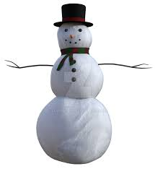


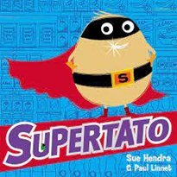




Windmill and Low Road Primary School
EYFS - Reception Spring 1 Overview Houses and Homes
Possible lines of Enquiry – these are the planned for learning moments that children will experience in addition to their own child led learning enquiries.
Seasonal Change – Winter
Houses and Homes
Chinese New Year
Personal, Social and Emotional Development
Children understand behavioural expectations of the setting. Children can independently manage their own needs; eating, drinking, accessing snack when hungry and communicate own needs in relation to being thirsty, hungry, tired, using the toilet. Children are able to seek others to share activities and experiences.
Phonics – Little Wandle - Phase 3
ai ee igh oa oo oo ar or ur ow oi ear air er
Tricky Words
was you they my by all are sure pure
Communication and Language Development
Children’s communication and language development underpins every area of learning. The children will be learning to listen attentively in a range of situations including carpet times and understand the need to take turns during conversations. They will be able to predict what might happen next in a story and offer explanations for why things happen.
Maths
Introducing zero
Comparison & composition of numbers to 5
Representing, comparing, composition, formation of 6,7,8
One more, one less
Combining two groups (adding)
3D shapes
Comparing Mass, capacity, length, height
Time
Physical Development
This half term we will be learning to co-ordinate our body movements by participating in Squiggle Me into a Writer sessions, Drawing Club, using a knife and fork at lunchtime as well as taking part in weekly PE sessions.
In PE we will be learning to:
Confidently try new challenges.
Combine movements, selecting actions in response to the task and apparatus.
Confidently and safely use a range of large and small apparatus.
Negotiate space safely with consideration for ourselves and others.
Follow instructions involving several ideas or actions.
Use movement skills with developing strength, balance and co-ordination showing increasing control and grace.
Work co-operatively with others and take turns.
Poetry Basket
Popcorn
A little house
Let's put on our mittens
I can build a snowman
Carrot Nose
Knowledge & Understanding of the World
This half term we will make observations of the changes to the weather and natural environment as we enter the season of Winter. We will investigate as water turns into ice and notice how it melts again.
Through our focus story The Three Little pigs we will compare the different types of houses people live in and ponder whether all houses are made of bricks.
We will discover how Chinese New Year is celebrated by listening to music, watching traditional dancing, tasting food and learning about the Chinese Zodiac through The Great Race story.
Pancake day – we will be measuring the ingredients, mixing the batter and flipping the pancakes and discovering each other’s favourite toppings.
Artist Focus – Piet Mondrian
Our artist focus this half term is Piet Mondrian. As we learn about 4 sided shapes in our maths lessons we will create artwork using shapes and rectangles.
Literacy - Focus Stories
For further information, please see the school website for EYFS long term plans.

Slide 2
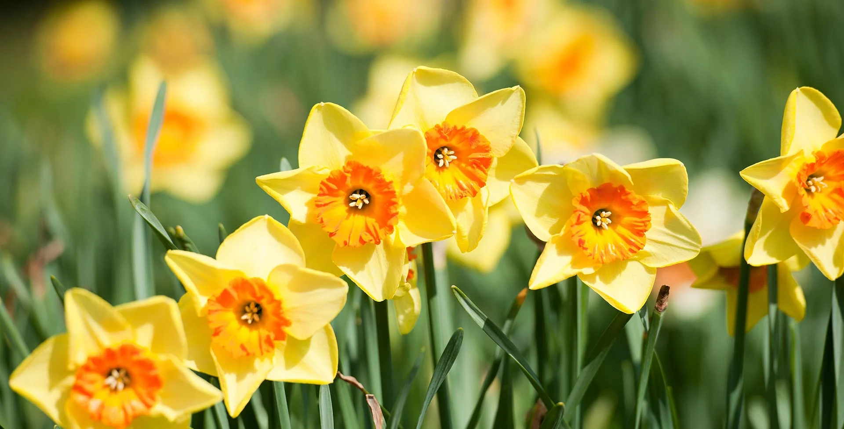
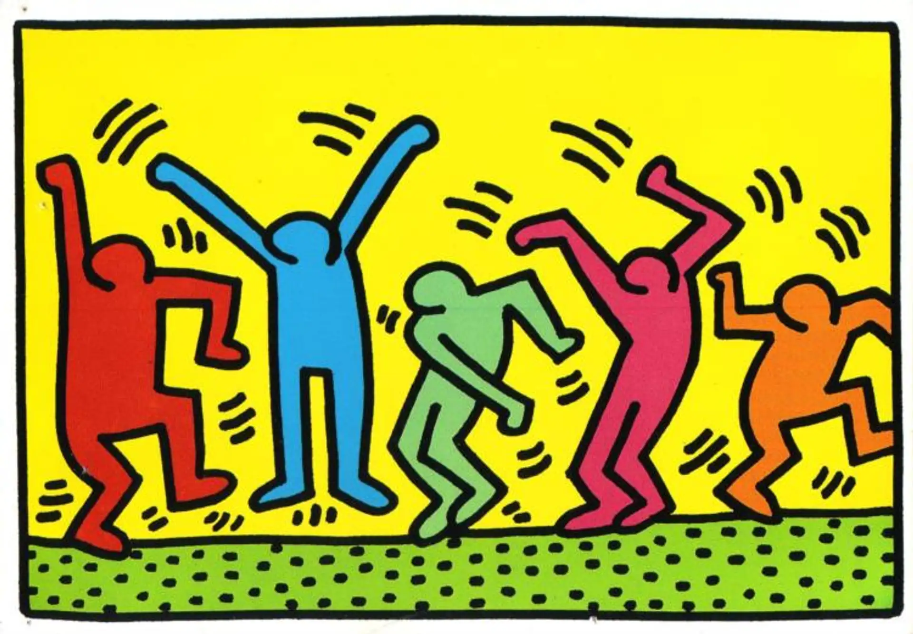
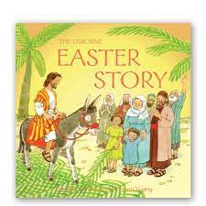
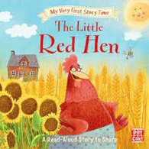

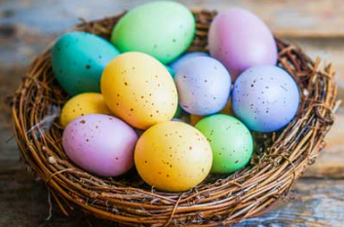
Windmill and Low Road Primary School
EYFS - Reception Spring 2 overview Healthy Me
Possible lines of Enquiry – these are the planned for learning moments that children will experience in addition to their own child led learning enquiries.
Seasonal Change – Spring
Growing and Changing
Easter Around the World
Space Exploration
Personal, Social and Emotional Development
Children know who to turn to if they need help or are worried. Children can talk bout the different factors that support their overall health and well – being such as a healthy diet, tooth brushing and sensible amounts of screen time. Children can use language to negotiate and organise play with others.
Communication and Language Development
Children’s communication and language development underpins every area of learning. The children will understand why listening is important with both peers and adults. They will ask questions to seek clarification of a text or task. Through talk and play situations children will re-tell familiar stories and create their own. During discussions they will use conjunctions such as ‘and’ or ‘because’ to extend their sentences.
Phonics – Little Wandle - Phase 3
Review all Phase 3 graphemes
Tricky Words
Review and secure spellings of all Tricky Words
Physical Development
This half term we will be learning to co-ordinate our body movements by participating in Squiggle Me into a Writer sessions, Drawing Club, using a knife and fork at lunchtime as well as taking part in weekly PE sessions.
In PE we will be learning to:
Confident to try new challenges and perform in front of others.
Combine movements, selecting actions in response to the task.
Negotiate space safely with consideration for myself and others.
Follow instructions involving several ideas or actions.
Show respect towards others when providing feedback.
Use movement skills with developing strength, balance and co-ordination showing increasing control and grace.
Poetry Basket
Pancakes
Spring Wind
Furry furry squirrel
Hungry Birdies
A Little Seed
Mrs Bluebird
Maths
Representing, comparing, composition and formation of 9, 10
One more, one less
Combining two groups
Number bonds
3D shapes
AB Pattern - continue, copy, and create repeating patterns.
Knowledge & Understanding of the World
This half term we will make observations of the changes to the weather and natural environment as we investigate the signs of Spring.
We will learn about the Easter Story and the different ways Easter is celebrated within our class family and the wider world.
Through our focus text ‘Look Up!’ we will explore space and enjoy an immersive experience in a planetarium.
Throughout the half term we will discover more about our bodies, including the ways to keep ourselves healthy through diet, exercise and good oral hygiene.
Artist Focus – Keith Haring
As we learn about how to keep our bodies healthy we will use Keith Haring’s artwork as our inspiration to create sculptures and artwork of people.
Literacy - Focus Stories
For further information, please see the school website for EYFS long term plans.

