Slide 1
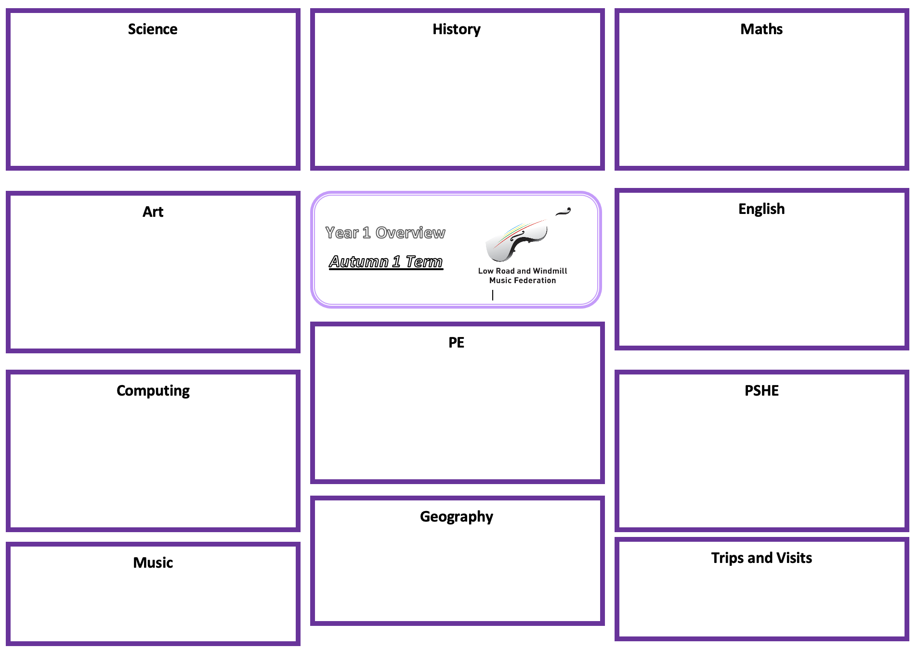
Science – Animals Including Humans – Ourselves.
History:
Maths:
identify, name, draw and label the basic parts of the human body and say which part of the body is associated with each sense
Asking simple questions and recognising that they can be answered in different ways
Observing closely, using simple equipment
Performing simple tests
Identifying and classifying
Using their observations and ideas to suggest answers to questions
Gathering and recording data to help in answering questions
Sort, count, group, compare and represent objects to 10.
Count forwards and backwards within 10.
Know one more and one less within 10
Know and use the symbols that represent greater and less than
Order numbers to 10
To know, understand and apply the use of a part-whole model
To know, understand and apply the mathematical symbol for addition.
To know and compare addition fact families and number bonds
within 10
N/A
Art: Drawing
English:
To explore a range of drawing media
Use coloured pencils with increasing accuracy, show different tones by using coloured pencils
Controlled use of line to create simple forms from observations
Use of imagination to form simple images
Show pattern and texture by adding dots and lines
Non-fiction: labels, lists and captions
Non-Fiction: Recount
Fiction: Traditional Tales
See individual teachers MTP for specific outcomes.
Autumn 1
Autumn 1
P.E: Ball Skills
To develop control and co-ordination when dribbling a ball with your hands
To explore throwing with accuracy towards a target
To explore accuracy when rolling a ball
To explore catching with two hands
To explore control and co-ordination when dribbling a ball with your feet
To explore tracking a ball that is coming towards me
Computing:
Photography and E-safety
PSHE: Fun Times
Music Technology
• Learn that computers can be used to produce music, either with synthesisers or samples
• Learn that music follows structure and that the different parts of a song have different names e.g. verse/chorus • Apply this practically on the app garage band by using loops to create short songs that follow a typical pop structure
• Begin to understand how to use filters to locate certain files by changing the instrument button to navigate through the samples
To learn about food that is associated with special times, in different cultures, celebrations and customs.
Recognise how active playground games make them feel
Make choices about which game to play, based on their feelings, likes and dislikes and what they are good at
To know about some of the effects of too much sun on the body
To describe what people can do to protect their bodies from being damaged by the sun
To know what they will need and who to ask for help if they going out in strong sun
Geography: Our Local Area
Describe places they go to often and rarely, and what they see on the way to school.
To understand what is near to school, far away from school and to gain a sense of place
To use and understand a simple plan of the classroom
To understand and use a local area map
To identify the destination of our fieldtrip, and recall the journey to get there
To be able to remember a local journey and the stages in order
Music:
Trips and Visits:
Learn to find a partner in musicianship to perform simple clapping games set to songs.
Learn actions and lyrics in longer song repertoire
Explore our “musical pencils” - using our fingers to draw the shape of music we listen to in class.
Ledston Woods

