Slide 1
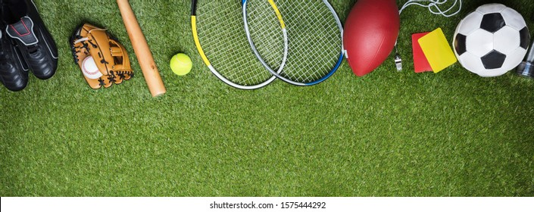
Year 2 – Low Road and Windmill Music Federation
Year 2
April 2025
We hope you have all had a wonderful holiday and are ready for another exciting half term.
Curriculum
Over this half term, Year 2 will be focusing on the following curriculum areas:
English
At the beginning of this half term we will be reading the adventure story ‘Captain Flinn and the Pirate Dinosaurs’. As part of this unit, we will be planning and writing an alternative adventure for the story. We will be doing lots of grammar based work to make sure that we are writing in the correct tense and we will be using adjectives and adverbs to make our writing interesting to read. We have started looking at contractions and we will continue to try to use these in our work. Later in the half term, we will move on instructional writing where we will use imperative verbs, time conjunctions and write in chronological order.
Reading and Phonics
Please continue to read with your child at least 3 times a week at home. This is hugely beneficial to your child’s reading development and will also help to foster a love of reading. Even though we send leveled reading books home, you can read anything with your children – comics, magazines, books that you have a home – anything that interests them!
In June, some children will be retaking the phonics screening test from Year 1. If your child is doing this, their teacher will send home some revision resources in the first week of the half term.
Maths
This half term we will learn about fractions. We will begin by understanding parts and wholes and equal and unequal parts. We will then go on to recognize and find halves, quarters and thirds. At the end of this unit we will learn to count in fractions. After this, we will learn to tell the time. We will begin by revising o’clock and half past, then move onto quarter past and quarter to. We will look at telling time to 5 minute intervals past and to the hour.
Science – Plants
Our science lessons this half term focus on learning about plants. We have two main learning objectives to explore: to observe and describe how seeds and bulbs grow into mature plants
and to find out what plants need to grow and stay healthy. We will be doing lots investigations into growing plants to help us learn about this.
Geography – Our Wonderful World
This topic focuses on pupils developing an understanding of the world around them. They will learn to name and locate the seven continents of the world and the oceans that surround them. They will begin to understand geographical similarities and differences about places when studying both human and physical geography. We will practise using maps and atlases to help us during this topic.
Pumps
In all year groups, children should have indoor pumps to wear when in school. Please ensure that your child has pumps which are labelled with their name to keep in school.
https://classroom.google.com
All homework will be set on Google Classroom.
It will be set on Friday and due the following Friday.
Please let your class teacher know if you require assistance logging on.
2AW – Outdoor Wednesday, Indoor Thursday
2L – Indoor Monday, Outdoor Friday
2W – Indoor Wednesday, Outdoor Thursday
Please ensure your child has an appropriate PE kit in school on the day of their lesson. For outdoor PE, children will need trainers . Unless there is torrential rain, all outdoor lessons will go ahead – please ensure jogging bottoms and jumpers are part of your child’s PE kit on outdoor PE days.

