Slide 1
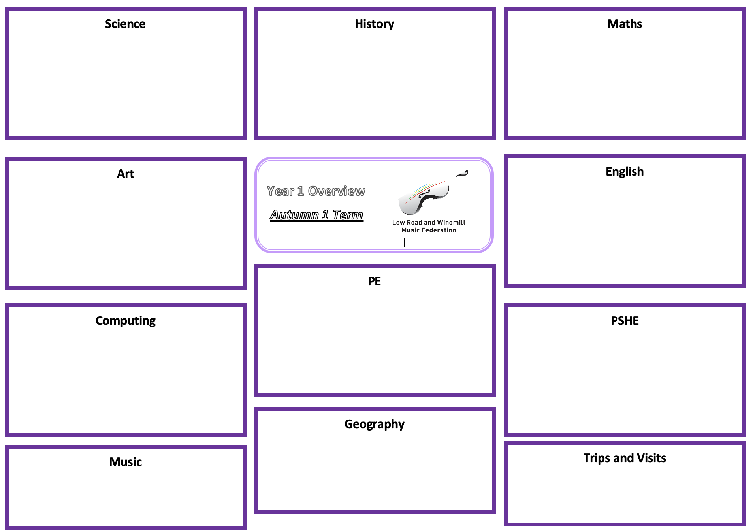
Science: Everyday Materials
History: Holidays
Maths: See individual teachers MTP for specific outcomes.
Identify and compare the suitability of a variety of everyday materials,
including wood, metal, plastic, glass, brick, rock, paper and cardboard
Find out how the shapes of solid objects made from some materials can be changed by squashing, bending, twisting and stretching
Asking simple questions and recognising that they can be answered in
different ways
Observing closely, using simple equipment
Performing simple tests
Identifying and classifying
Using their observations and ideas to suggest answers to questions
Gathering and recording data to help in answering questions
Learn about changes within living memory
Understand historical concepts such as continuity and change, similarity and difference
Ask historically valid questions
Identify similarities and differences between ways of life in different periods
Ask and answer questions
Understand some of the ways in which we find out about the past
Identify different ways in which the past is represented
Use a wide range of everyday historical terms
Use parts of stories and other sources to show they know and understand key features of events
Use sources to show they know and understand the past
Suggest reasons why changes took place
Beginning to understand multiplication and division
To measure in centimeters and meters
To order and compare lengths and heights
To compare mass
To measure in grams and kilograms
To measure in milliliters and liters
To learn about temperature
Art: Craft and Design
English:
Draw a map of their journey to school, including key landmarks and different types of mark-making.
Follow instructions to make a piece of felt that holds together and resembles their map.
Decide how to place ‘jigsaw’ pieces to create an abstract composition.
Make choices about which details from their map to include in a stained glass.
Cut cellophane shapes with care and arrange them into a pleasing composition.
Design a print with simple lines and shapes, making improvements as they work.
Follow a process to make and print from a polystyrene tile.
Year 2 Overview
Spring 2
Setting Description
Performance Poetry
Instructions
Spring 2
See individual teachers MTP’s for specific outcomes
P.E: Fitness
To understand how to run for longer periods of time without stopping
To develop co-ordination and timing when jumping in a long rope
To develop individual skipping
To take part in a circuit to develop stamina and agility
To explore exercises that use your own body weight
To develop ‘ABC,’ agility, balance and co-ordination.
Computing: Tech 2
PSHE: Sex and relationship education – boys, girls and family.
Use technology purposefully to create, organise, store, manipulate and retrieve digital content.
Recognise common uses of information technology beyond school. Use technology safely and respectfully, keeping personal information private; identify where to go for help and support when they have concerns about content or contact on the internet or other online technologies.
To understand how to use technology for communication
Define difference and similarity
Understand that boys and girls can do the same tasks and enjoy the same things, but that stories, TV and people sometimes say boys do this and girls do that
Know that female mammals give birth and nurse their young
Describe the biological differences between male and female
Understand that the creation of life requires a male and female
Identify and name biological terms for male and female sex parts
Can label the male and female sex parts with confidence
Understand that the male and female sex parts are related to reproduction
can identify key stages in the human life cycle understand some ways they have changed since
they were babies
Understand that all living things including humans start life as babies
Understand that we all have different needs and require different types of care
Identify ways we show care towards each other
Understand the links between needs, caring and
Geography:
Music:
Trips and Visits:
Abbey House Museum – Holidays in the past workshops

