Slide 1
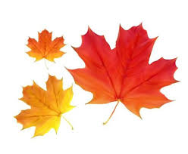

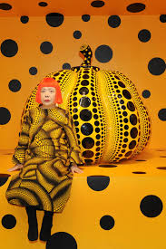
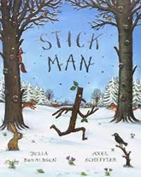
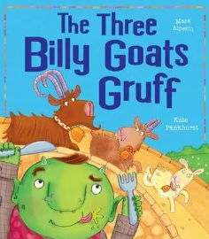
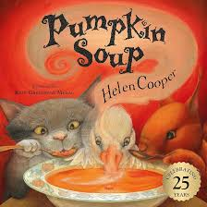
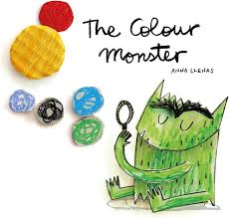

Windmill and Low Road Primary School
EYFS - Reception Autumn 1 overview Getting to Know You
Possible lines of Enquiry – these are the planned for learning moments that children will experience in addition to their own child led learning enquiries.
Seasonal Change – Autumn
All about Me and my family
Learning school rules and routines
Personal, Social and Emotional Development
Children will begin to develop a growing sense of awareness of their own feelings. Each day when they arrive they will put their name into a feeling pot and have the chance to day how they are feeling on that day. They will show an increasing understanding of the rules and routines at school and learn to organise themselves within the school day. They will build friendships with others and learn how to share and negotiate play ideas.
Communication and Language Development
Children’s communication and language development underpins every area of learning. The children will be learning to listen to others 1:1 and in small groups, listening to and following simple instructions, developing their vocabulary through interactions with their peers and adults and learning a learning a repertoire of songs and rhymes.
Phonics – Little Wandle - Phase 2
s a t p i n m d g o c k ck e u r h b f l
Tricky Words
is I the
Physical Development
This half term we will be learning to co-ordinate our body movements by participating in Squiggle Whilst You Wiggle, Squiggle me into a Writer, Drawing Club sessions, using a knife and fork at lunchtime and taking part in weekly PE sessions.
In PE we will be learning to:
Make independent choices.
Negotiate space safely with consideration for ourselves and others.
Follow instructions involving several ideas or actions.
Play co-operatively and take turns with others.
Understand the rules and can explain why it is important to follow them.
Use movement skills with developing balance and coordination.
Poetry Basket
Chop Chop
Cup of Tea
Pointy Hat
Falling Apples
Leaves are falling
Five Little pumpkins
Maths
Number: Who is here / not here?
Comparing dinner register numbers.
Time - Key routines of the day
Positional Language - Where do things belong?
Time - Days of the week
Matching, Sorting & Comparing amounts.
Talk about measures and patterns.
Knowledge & Understanding of the World
This half term we will be investigating the season Autumn. We will go on a seasonal walk into our local environment and look for the changes that we can see happening around us. We will identify and collect Autumnal items such as conkers, pinecones and leaves and explore them further in school.
We will be exploring Halloween and the different ways children in our class celebrate. We will use our senses to investigate pumpkins, how they feel, how they smell and discovering what they look like inside.
In the Enterprise Suite we will use the pumpkins to make a delicious and healthy pumpkin soup.
Artist Focus - Yayoi Kusama
Our artist focus this half term is contemporary artist Yayoi Kusama. We will explore her inspirational vegetable polka dot art.
Literacy - Focus Stories
For further information, please see the school website for EYFS long term plans.

Slide 2
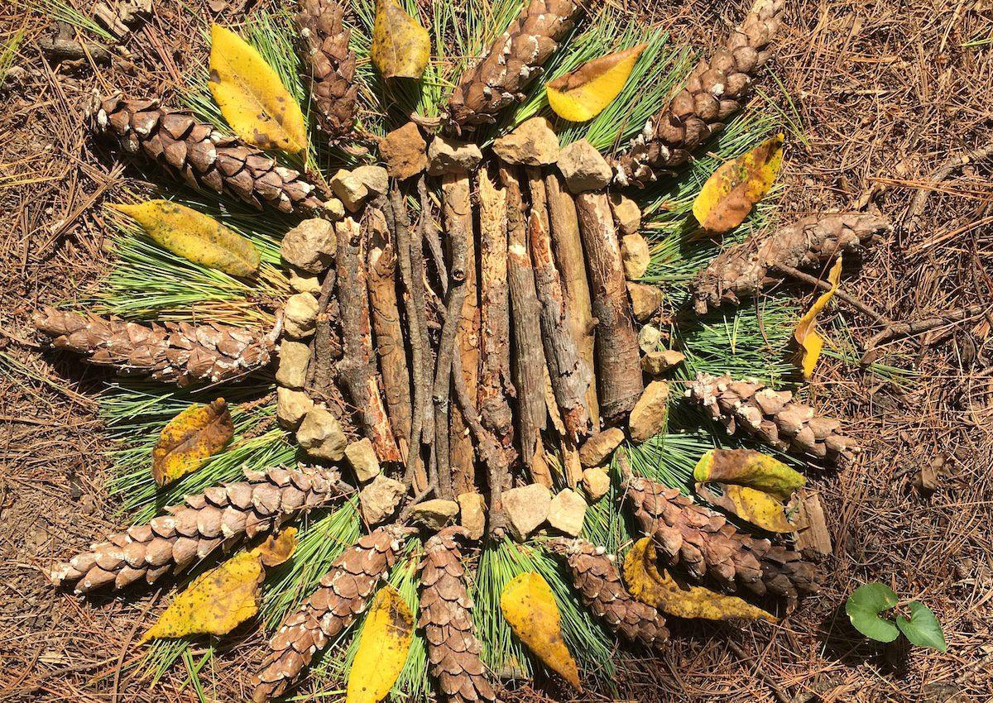
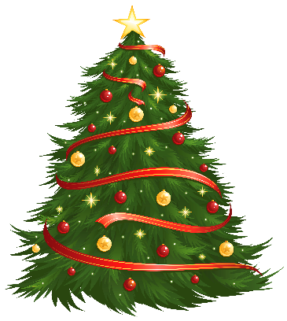
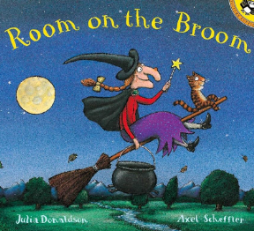

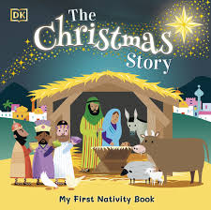
Windmill and Low Road Primary School
EYFS - Reception Autumn 2 overview Celebrations
Possible lines of Enquiry – these are the planned for learning moments that children will experience in addition to their own child led learning enquiries.
Celebrations
Family, cultures and traditions
Christmas Around the World
Personal, Social and Emotional Development
Children will show care and concern for others and show an increasing awareness of the feelings of others. They can independently choose areas they would like to play in or resources they would like to use. Children can seek out adults and peers when they need help.
Communication and Language Development
Children’s communication and language development underpins every area of learning. The children will be learning to listen in a variety of situations, and respond appropriately to others during play. They will engage in story times and respond appropriately to comments and questions when asked.
Phonics – Little Wandle - Phase 2
ff ll ss jv w x yz zz qu ch sh th ng nk
Tricky Words
as his her go no to into she he we be me of
Physical Development
This half term we will be learning to co-ordinate our body movements by participating in Squiggle me into a Writer sessions, Drawing Club, using a knife and fork at lunchtime and taking part in weekly PE sessions.
In PE we will be learning to:
Try new challenges and confidently decide on the skills needed to complete the task.
Negotiate spaces safely with consideration for ourselves and others.
Follow instructions involving several ideas or actions.
Play co-operatively, take turns and congratulate others.
Play games honestly with consideration of the rules.
Show an understanding of own feelings and can regulate own behaviour.
Use movement skills with developing balance and co-ordination.
Poetry Basket
Pointy Hat
Five Little Pumpkins
I'm a Little Elf
In my Christmas Den
Out of the corner of my eye
Robin is my name
Whether the weather
Maths
Representing, comparing, composition, formation of 1,2,3,4,5
One more, one less
Combining two groups (addition)
Shapes focus- circle, triangle, square, rectangle pentagon.
Positional language
Time
Knowledge & Understanding of the World
This half term we will continue our explorations of Autumn and make observations of the changes to the weather and the natural environment around us.
We will learn about celebrations and special events such as Remembrance Day, Diwali, Christmas and the different ways this is celebrated within our class family and the wider world. We will make and taste traditional food eaten when celebrating Diwali.
Through our focus text ‘The Squirrel who Squabbled’ we will learn about British wildlife and learn about where they live and how they change and grow over time.
As we learn how to keep ourselves safe during bonfire night we will have a visit from a real fire engine and learn about the role of a fire fighter.
Artist Focus – Andy Goldsworthy
Our artist focus this half term is Andy Goldsworthy. We will create our own transient art masterpieces by creating poppies for Remembrance Day and using natural Autumnal materials to create patterns.
Literacy - Focus Stories
For further information, please see the school website for EYFS long term plans.

