Slide 1
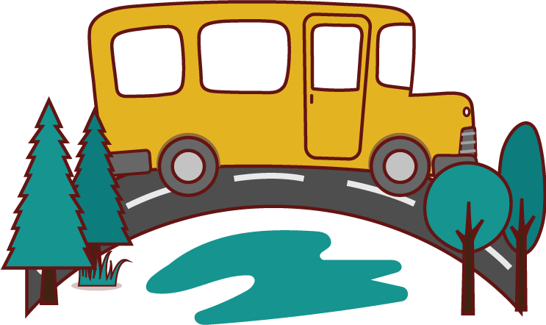
Year 1 – Low Road and Windmill Music Federation
Year 1
April 2025
“If April showers should come your way, they bring the flowers that bloom in May.”
We hope that you all had a lovely half term break and a well deserved rest. If you have any questions for class teachers, please contact the office to make an appointment or contact teachers via Google Classroom.
Reading
At Low Road and Windmill Music Federation, we love to read! Children are encouraged to read 3 or more times at home during the week and record this in their reading journals. Reading journals are checked daily in school and children that have read frequently will win prizes and take part in the golden egg hunt.
Please look out for a Google Classroom post about our special reading session in our school library. All sessions run from 2:45 until 3:05.
PE Kit Reminder
It is important all children bring their PE kits for both sessions. As the weather turns warmer, please be mindful of appropriate PE kit, including shorts and sun cream.
Here is the half term overview of what your child will be learning with us in Year 1! We have such an exciting learning journey ahead!
Maths
Multiplication and Division
In Maths, we explore the world of multiplication and division for the first time. We start by counting in 2s, 5s and 10s before identifying and adding equal groups of objects. We learn how to make arrays and doubles before making equal groups using lots of practical equipment.
Fractions
Within our learning, we explore the concept of half and a quarter. We start by learning how to recognise and identify half of an object in practical ways before finding half of a quantity using objects within our classroom. This learning process is then mirrored for finding a quarter, both of shapes and a quantity. We explore cutting shapes and objects in different ways to ensure we have a secure understanding of our fractions.
Geometry: Position and direction
Our final topic for Summer 1 is position and direction. We start by learning and describing a variety of turns before identifying left, right, forwards and backwards, where we join in with songs that help us remember these directions. We use prepositional language such as above and below to place objects appropriately before learning ordinal numbers. This is great preparation for our sports day!
https://classroom.google.com
If you need help logging on, please ask your class teacher.
Homework is handed out on a Friday and due back the following Friday. This will be on Google Classroom.
School Trip – Skelton Grange
1S – Wednesday 30th April
1W – Tuesday 6th May
1T – Thursday 12th June

Slide 2
Year 1 – Low Road and Windmill Music Federation
Year 1
April 2025
https://classroom.google.com
If you need help logging on, please ask your class teacher.
Homework is handed out on a Friday and due back the following Friday. This will be on Google Classroom.
School Trip – Skelton Grange
1S – Wednesday 30th April
1W – Tuesday 6th May
1T – Thursday 12th June
“If April showers should come your way, they bring the flowers that bloom in May.”
English
Non-Fiction: Non-Chronological Reports - Fact File
Equipped with our newfound knowledge from Geography, we become researchers and create wonderful fact files that showcase our understanding of penguins. From creating a engaging heading to detailed descriptions of the penguin species and fun facts throughout, each fact file is unique and captures our creativity and dedication to learning.
Fiction: Setting description
Following on, we explore the story of ‘The Snail and the Whale’. We read and answer questions about this wonderful story before describing a setting using our senses and our wonderful bank of adjectives that we have gained throughout the year. Together, we learn how to write a successful setting description and all of the features needed to create one before writing our very own. Within this topic, we learn about the importance of plurals and using the suffix un successfully. We share our setting descriptions with our friends and enjoy describing the wonderful settings within the story.
Poetry: Riddles
Our final topic of learning is Poetry where we focus on riddles!. As a class, we listen and read a range of riddles before discussing how to make one of our own. Using our knowledge, we create ‘What am I?’ riddles that we share with our friends using lots of adjectives to describe our noun. We have such fun trying to guess what our friends are describing!
Geography
Animals and their Habitat
This half term we have a Geography focus, where we learn about the seven continents and the five oceans of our world. Within each lesson, we focus on a different continent and explore the animals and their habitats. We explore and learn about penguins in Antarctica, pandas in Asia, the whale shark in Oceania and elephants in Africa. We gain an understanding into animal movements and migrations across various countries and landscapes gaining a deeper understanding of the interconnectedness of animals and their environments.
Science
Wonderful Weather
In Science, we embark on our new topic of ‘Wonderful Weather’. Working together, we learn and explore the mysteries of seasonal change and the captivating world of weather. We learn how weather changes in different seasons before conducting lots of experiments, such as making wind socks and rain gauges to work scientifically and measure changes in our weather.

