Slide 1
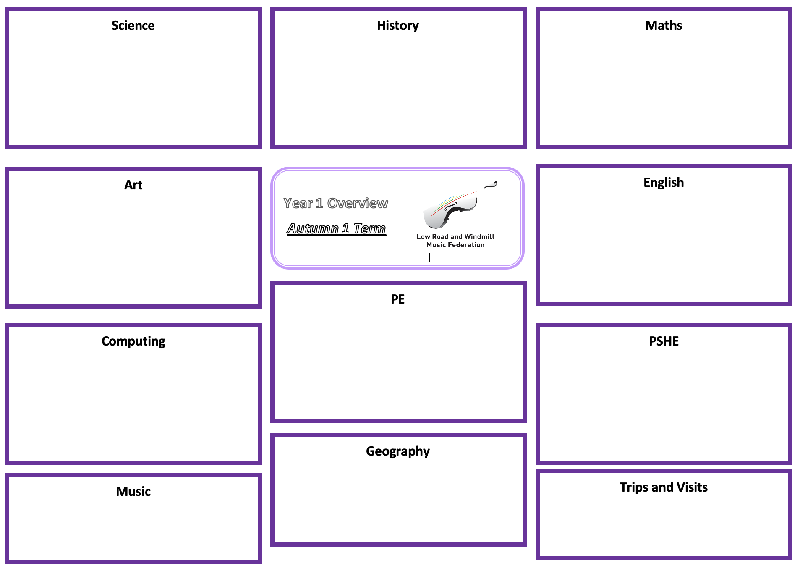
Science: Animals – Living things and their Habitats
History: Bonfire Night and the Great Fire of London.
Maths: See individual teachers MTP for specific outcomes.
Explore and compare the differences between things that are living, dead, and things that have never been alive
Identify that most living things live in habitats to which they are suited and describe how different habitats provide for the basic needs of different kinds of animals and plants, and how they depend on each other
Asking simple questions and recognising that they can be answered in different ways
Observing closely, using simple equipment
Performing simple tests
Identifying and classifying
Using their observations and ideas to suggest answers to questions.
Add and subtract two 2-digit numbers
Find and make number bonds to 100
Add three 1 digit numbers
Recognising coins and notes
Counting money in pence, pounds, notes and coins.
Make the same amount
Compare money
Find the total, difference and change
Solve two-step problems
Make and add equal groups
Make arrays
Develop an awareness of the past, using common words and phrases relating to the passing of time
Choose and use parts of stories and other sources that they know and understand key features of events
Understand some of the ways in which we find out about the past Identify different ways in which it is represented
Use a wide vocabulary of everyday historical terms
Know where events they study fit within a chronological framework.
Art: Festivals and Celebrations
English:
During Christmas term there will not be an explicit skill focus. Art will be delivered through topic- Festivals and Celebrations. The objectives will be broadened to:
Use a range of materials creatively to design and make products
Use drawing, painting, sculpture and painting to develop and share their ideas, experiences and imagination.
To develop a wide range of art and design techniques in using colour, pattern, texture, line, shape, form and space.
Year 2 Topic
Web
Shape poetry/acrostic poetry
Recount (diary entry)
Story with PSHE focus
P.E: Dance
THEME: Exploring space and travel. To repeat, link and choose actions
THEME: Actions and rhythms. To create actions and accurately copy other's actions
THEME: The Circus. To copy, remember and repeat actions using facial expressions to show different characters
THEME: The Circus. To perform in unison creating shapes with a partner
THEME: Mirrors. To be able to mirror a partner and create ideas.
THEME: The Rainforest. To copy, repeat and create actions in response to a stimulus
THEME: The Rainforest. To copy, create and perform actions considering dynamics
THEME: The Rainforest. To create a short dance phrase with a partner showing clear changes of speed
Computing: Music Tech
PSHE: Friendship
Unpick different song/music genres and how these are created using technology
Record the song made from live loops and export to teacher ipad
Create a song that has 4 sections - one for each genre of music we have learnt about and save the project
Can identify people who are special to them understand what makes a good friend
Can demonstrate how they show someone they care
understand how people might feel if they are left out or excluded from friendships
Recognise when someone needs a friend and
Know some ways to approach making friends
Know who they can talk to if they are worried about friendships
British Values: (link to PSHE lessons)
To develop an understanding of voting rights from the past to now. (Democracy)
Fire safety rules and To understand right from wrong ((Rule of Law and respect)
Can identify how to respect other cultures, differences and race (Tolerance)
Music:
By the end of this term, learn to recognise silence in music with single beat rests (shh). First present as part of our songs, then written down.
Rhythm practiced through reading, writing and with songs and rhymes.
Develop instrument vocabulary, and able to recognise instruments from listening activities.
Trips and Visits:
TBC in SPRING 1
TBC in SPRING 1

