Slide 1
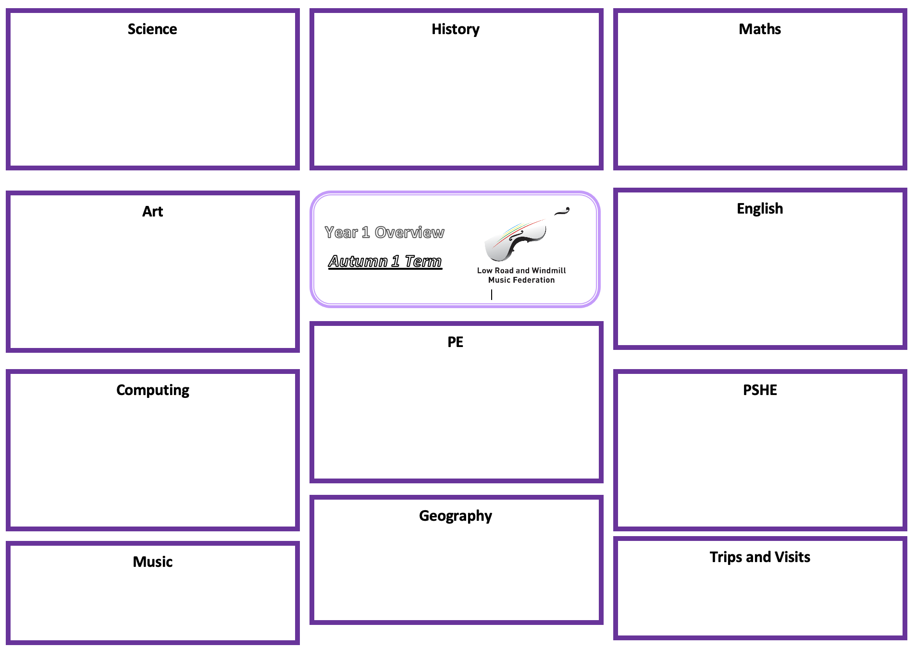
Science: Plants
Observe and describe how seeds and bulbs grow into mature plants
Find out and describe how plants need water, light and a suitable temperature to grow and stay healthy
History:
Maths: See individual teachers MTP for specific outcomes.
Fractions:
Recognising equal and unequal parts
Recognise and find a whole, half, quarter, third and three-quarters
Understand unit and non unit fractions
Count in fractions
Time:
Tell the time to o’clock, half past, quarter past and quarter to.
Tell the time to 5 minutes intervals.
Understand minutes in an hour and hours in a day.
Art: Sculpture
Flatten and smooth clay, rolling shapes successfully and making a range of marks in clay.
Make a basic pinch pot and join at least one clay shape onto the side using the scoring and slipping technique.
Roll a smooth tile surface.
Join clay shapes and make marks in the tile surface to create a pattern.
Draw a house design and plan how to create the key features in clay.
Create a clay house tile that has recognisable features made by both impressing objects into the surface and by joining simple shapes.
English:
Fiction: Story endings
Instructions
.
Year 2 Overview
Summer 1
Spring 2
See individual teachers MTP’s for specific outcomes
P.E: Team Building
To follow instructions and work with others.
To co-operate and communicate in a small group to solve challenges.
To create a plan with a group to solve the challenge.
To communicate effectively and develop trust.
To use teamwork skills to work as a group to solve problems.
To work with a group to copy and create a basic map.
Computing: Tech 2
PSHE: Keeping Safe and Managing Risk
Describe what to do if there is an emergency
Understand that they can take some responsibility for their own safety
Know some rules for keeping safe outside
Can assess whether a situation is safe or unsafe
Understand the importance of always telling someone where they are going or playing
Can identify hazards in relation to road safety
Are able to explain how to cross the road safely
Recognise that there are rules in relation to road safety for all road users
Use technology purposefully to create, organise, store, manipulate and retrieve digital content.
Recognise common uses of information technology beyond school. Use technology safely and respectfully, keeping personal information private; identify where to go for help and support when they have concerns about content or contact on the internet or other online technologies.
To understand how to use technology for communication
Geography: Our Wonderful World
Name, locate and identify characteristics of the seven continents and oceans
Use world maps, atlases and globes
Understand geographical similarities and differences when studying both human and physical geography
Identify the locations of hot and cold areas around the world Use basic vocabulary to refer to physical and human features Develop knowledge about the world
Music:
Opportunity to perform sung solos or duets using do, mi, so and la notes.
Encouraged to improvise using ta/ti-ti and silence in single beat rests.
Experience more pentatonic songs to prepare new notes in musicianship.
Trips and Visits:

