Slide 1
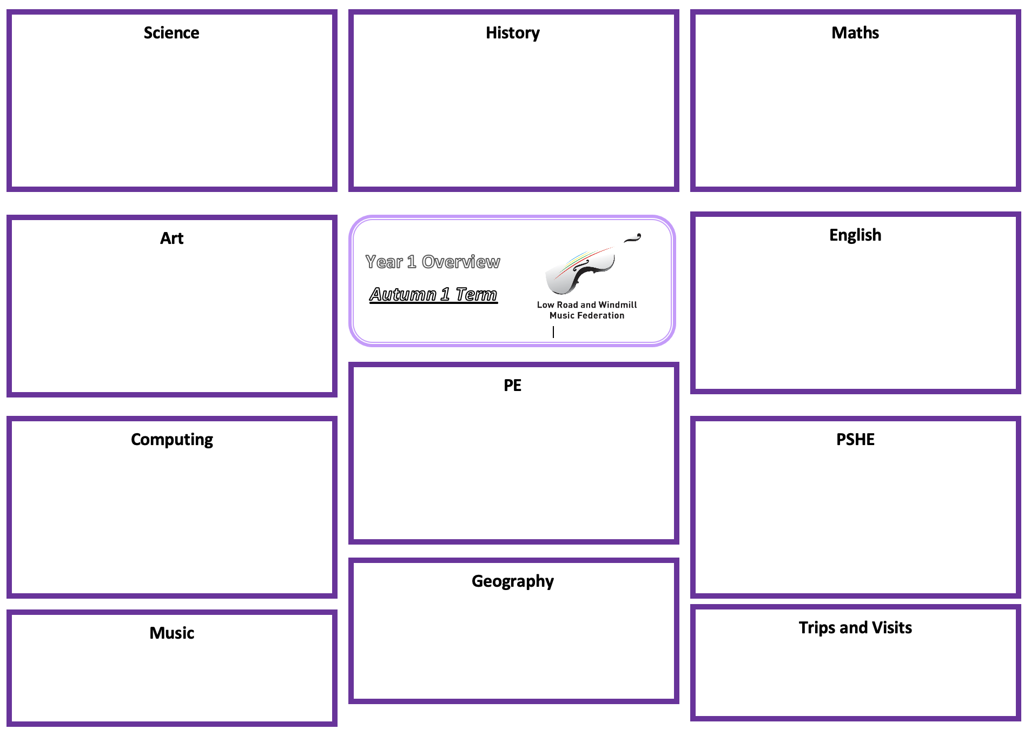
Science: Seasonal Changes - Wonderful Weather
History:
Maths: Multiplication and Division, Fractions and Geometry: Position and Direction
To observe changes across the four seasons
To observe and describe weather associated with the seasons and how day length varies
To ask simple questions and recognising that they can be answered in different ways
To observe closely, using simple equipment and perform simple tests
To identify and classify
To use observations and ideas to suggest answers to questions
To gather and record data to help in answering questions
To count in 2s, 5s and 10s
To recognise and add equal groups
To make arrays
To make doubles
To make equal groups by grouping and sharing
To recognise and find half an object or a shape
To recognise and find half of a quantity
To recognise and a quarter of an object or a shape
To recognise and find a quarter of a quantity
To describe turns
To describe position – left, right, forwards, backwards, above and below
To understand ordinal numbers
Commences Summer 2
Art: Sculpture and 3D: Paper Play
English
To roll paper to make 3D structures.
To shape paper to make a 3D drawing.
To apply paper-shaping skills to make an imaginative sculpture.
To work collaboratively to plan and create a sculpture.
To apply painting skills when working in 3D.
Non-Fiction: Non-chronological reports
To write a non-chronological report about Penguins
Fiction: Setting Description
To write a setting description based on the Snail and the Whale
Poetry: Riddles
To write a riddle
Summer 1
P.E: Team Building
To co-operate and communicate with a partner to solve challenges
To explore and develop teamwork skills
To develop communication skills
To use communication skills to lead a partner
To plan with a partner and small group to solve problems
To communicate with a group to solve challenges
Computing:
Animation 1
PSHE: Mental Health and Wellbeing – Feelings
To understand the Principles of information/ computation and how digital systems work
To evaluate and apply information technology, including new or unfamiliar technologies, analytically to solve problems
To be responsible, competent, confident and creative users of information and communication technology.
To be able to use, and express themselves and develop their ideas through, information and communication technology – at a level suitable for the future workplace and as active participants in a digital world
To use various Apps for a range of purposes, creative output in multiple ways, how computers are used in the work place
To create a stop motion animation project
To name different feelings (including good and not-so-good feelings)
To recognise that people may feel differently about the same situation
To identify how different emotions look and feel in the body
To recognise that some feelings can be stronger than others
To describe some ways of managing different feelings
To know when to ask for help
To give an example of when people might experience change or loss
To describe how people might feel when there is a change or loss
To recognise what they can do to help themselves or someone else who may be feeling unhappy
Geography: Animals and Their Habitats
To locate and describe the home of Emperor penguins and Asian pandas.
To describe specific place knowledge about the location of a significant animal
To locate a significant animal, and describe the African landscape in Namibia
To understand an animal’s yearly movements, and describe the countries it passes over
To explain and understand the locations and places studied in the different continents and oceans
Music:
To be able to sing songs with 3 notes (so, la, mi), copying our In Harmony tutor
To develop our singing posture - flexible and healthy when sitting in a circle or standing in choir to sing
To take part in clapping games to explore more than two alternating actions and may become more complex to include three or four actions
Trips and Visits:
TB
Skelton Grange
1S – Wednesday 30th April
1W – Tuesday 6th May
1T – Thursday 12th June

