Slide 1
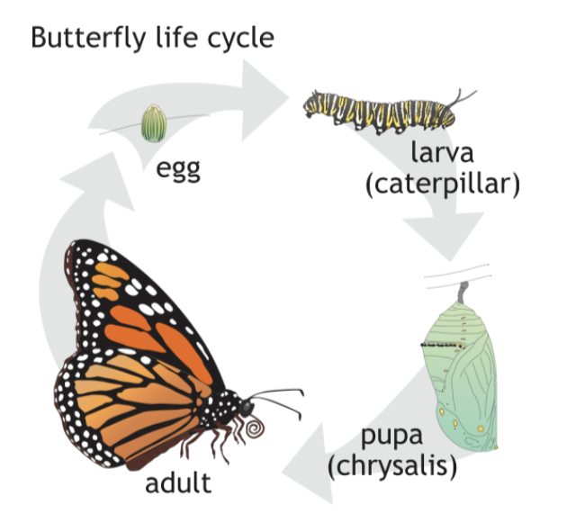

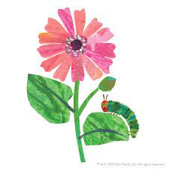

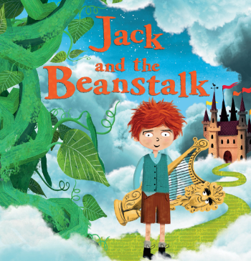
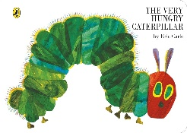

Windmill and Low Road Primary School
EYFS - Reception Summer 1 overview New Life
Possible lines of Enquiry – these are the planned for learning moments that children will experience in addition to their own child led learning enquiries.
New Life – Plants and Lifecycles
Minibeasts
Local Area
Personal, Social and Emotional Development
Can follow instructions, requests, and ideas in a range of situations. Show resilience and perseverance, a belief that with more effort or with a different approach success will occur. Can be considerate to the needs of others, beginning to respect a different point of view and work together in collaboration.
Communication and Language Development
Children’s communication and language development underpins every area of learning. The children will be learning to listen to others whilst focussed on a different task. During play situations they can take on board the ideas of others in order to keep play going. They will use newly learnt vocabulary in conversation and play. Use language purposefully to recall an event or to express their own ideas and feelings.
Phonics – Little Wandle - Phase 4
Read Phase 4 words
Tricky Words
said so have like some come love do were here little says there when what one out today
Physical Development
This half term we will be learning to co-ordinate our body movements by participating in Squiggle Me into a Writer sessions, Drawing Club, using a knife and fork at lunchtime and we will begin to get ourselves dressed and undressed for PE.
In PE we will be learning to:
Negotiate space safely with consideration for ourselves and others.
Follow instructions involving several ideas or actions.
Persevere when trying new challenges.
Play ball games with consideration of the rules.
Play co-operatively and take turns with others.
Use ball skills with developing competence and accuracy.
Poetry Basket
I have a little frog
Five little peas
Sliced Bread
Dance
Pitter patter
A Little Shell
Maths
Number 10 and beyond– subitising, composition, counting, sorting, matching, comparing, ordering
Counting patterns to 10 and beyond
Spatial reasoning
3D shape
Match, rotate, and manipulate
Pattern – ABC, ABB, BBA
Artist Focus – Eric Carle
Eric Carle will be our inspiration this half term as we attempt to create our own tissue paper collages.
Knowledge & Understanding of the World
This half term we will take our investigations of Spring further by looking at new life. We will observe the metamorphosis of caterpillars into butterflies and attempt to grow our very own beanstalks from a bean.
In April we will find out about Saint George, the Patron Saint of England. We will discover the legend of St George and the dragon, create our own flags and shields before going on a parade around the playground.
Literacy - Focus Stories
For further information, please see the school website for EYFS long term plans.

Slide 2
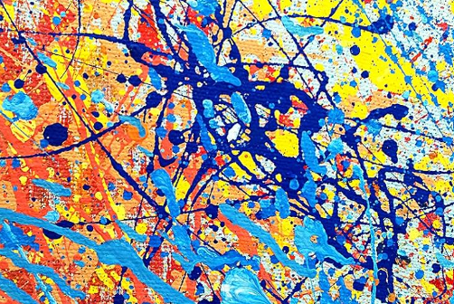
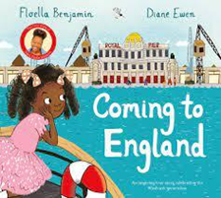


Windmill and Low Road Primary School
EYFS - Reception Summer 2 overview Animals and Habitats
Possible lines of Enquiry – these are the planned for learning moments that children will experience in addition to their own child led learning enquiries.
Seasonal Change - Summer
Animals and their habitats
Swithen’s Farm visit
Personal, Social and Emotional Development
Children are able to identify and moderate own feelings using some strategies to deal with anger and frustration. They can negotiate with others to solve problems and take steps to resolve conflict. Show awareness of how their actions may impact on others, know that other children think and respond in different ways to them.
Communication and Language Development
Children’s communication and language development underpins every area of learning. The children will be learning to Listen attentively and respond to what they hear with relevant questions, comments, or actions. Understand and use a range of vocabulary in different contexts and use conjunctions to extend their sentences and articulate their ideas.
Phonics – Little Wandle - Phase 4
Read Phase 4 words
Tricky Words
Review and secure spellings of all tricky words
Physical Development
This half term we will be learning to co-ordinate our body movements by participating in Squiggle Me into a Writer sessions, Drawing Club, using a knife and fork at lunchtime and be getting ourselves dressed and undressed for PE.
In PE we will be learning to:
Negotiate spaces safely with consideration for ourselves and others.
Follow instructions involving several ideas or actions.
Play co-operatively, take turns and encourage others.
Play games honestly with consideration of the rules.
Show an understanding of our own feelings and can regulate behaviour.
Use ball skills with developing competence and accuracy.
Use movement skills with developing balance and co-ordination.
Poetry Basket
The Fox
Monkey Babies
Thunderstorm
Five Little Owls
If I were so very small
Under a stone
Maths
Adding more
Taking away
Number bonds
Shape – spatial reasoning
Revisit doubles
Revisit sharing and grouping
Odd and Even
Develop patterns and relationships
Knowledge & Understanding of the World
This half term we will observe the changes that occur to the weather and our immediate environment in the Summer. During our Focus Story ‘Coming to England’ we will compare the weather in Trinidad to England.
Following on from our focus story ‘What the Ladybird Heard’, we will visit Swithen’s Farm in July to learn more about farm animals, how to care for them, what they eat and discover where they live on the farm.
We will use the story ‘The Trouble with Dragon’s’ to focus our learning on the environment and what we can do to be responsible citizens to care for the world in which we live.
Artist Focus – Jackson Pollock
We will take inspiration from Jackson Pollock using paint to drip, splat and splash to create an abstract piece of art.
Literacy - Focus Stories
For further information, please see the school website for EYFS long term plans.

